Slide 1
CSC2161
C++ Programming
Functions
Dieudonne U

Slide 2
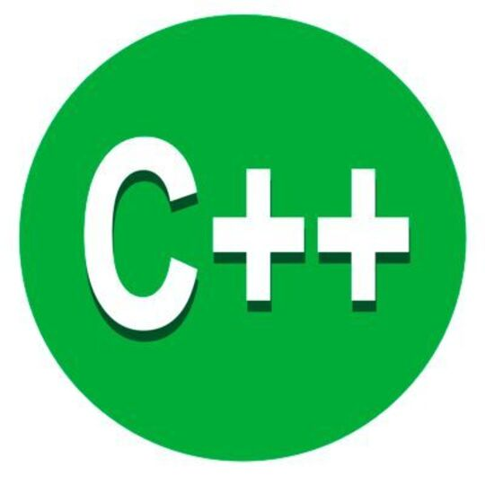
Agenda
Topic two
Topic three
Topic four

Slide 3
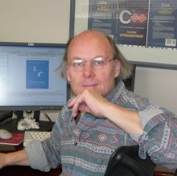
What are functions of C++?
A function is a block of code that performs some operation. A function can optionally define input parameters that enable callers to pass arguments into the function. A function can optionally return a value as output.

Slide 4

BENEFITS
MODULARITY (DECMPOSITION)
READABILITY
MAINTANABILITY
REUSABILITY

Slide 5
FUNCTION DEFINITION

Slide 6
C++ HAS ONE DEFINITION RULE (ODR): A FUNCTION CAN DECLARED OR INVOKED IN MANY DIFFERENT PLACES, BUT IT IS DEFINED IN ONE PLACE.
#include <iostream>
bool isPrime(int);
int main()
{
int n;
std::cout << "Enter a positive number\n";
std::cin >> n;
for (int i = 2; i < n; ++i)
{
if (isPrime(i))
std::cout << i << "\n";
}
return 0;
}
bool isPrime(int number)
{
if (number <= 1)
return false;
if (number == 2)
return true;
for (int i = 2; i < number; ++i)
if (number % i == 0)
return false;
return true;
}

Slide 7
C++ HAS ONE DEFINITION RULE (ODR): A FUNCTION CAN DECLARED OR INVOKED IN MANY DIFFERENT PLACES, BUT IT IS DEFINED IN ONE PLACE.
#include <iostream>
bool isPrime(int);
int main()
{
int n;
std::cout << "Enter a positive number\n";
std::cin >> n;
for (int i = 2; i < n; ++i)
{
if (isPrime(i))
std::cout << i << "\n";
}
return 0;
}
bool isPrime(int number)
{
if (number <= 1)
return false;
if (number == 2)
return true;
for (int i = 2; i < number; ++i)
if (number % i == 0)
return false;
return true;
}
PROTOTYPE
FUNCTION CALL
FUNCTION DEFINITION

Slide 8
FUNCTION PROTOTYPE : DECLARATION
Prototype is required when the function call comes before the compiler sees the function definition.
bool isPrime(int);
RETURN TYPE
FUNCTION NAME
LIST OF PARAMETERS

Slide 9
FUNCTION DEFINITION
bool isPrime(int number)
{
if (number <= 1)
return false;
if (number == 2)
return true;
for (int i = 2; i < number; ++i)
if (number % i == 0)
return false;
return true;
}
FUNCTION HEADER
FUNCTION BODY

Slide 10
FUNCTION CALL
if (isPrime(i))
Arguments
Function name

Slide 11
C++ HAS ONE DEFINITION RULE (ODR): A FUNCTION CAN DECLARED OR INVOKED IN MANY DIFFERENT PLACES, BUT IT IS DEFINED IN ONE PLACE.
#include <iostream>
bool isPrime(int);
int main()
{
int n;
std::cout << "Enter a positive number\n";
std::cin >> n;
for (int i = 2; i < n; ++i)
{
if (isPrime(i))
std::cout << i << "\n";
}
return 0;
}
bool isPrime(int number)
{
if (number <= 1)
return false;
if (number == 2)
return true;
for (int i = 2; i < number; ++i)
if (number % i == 0)
return false;
return true;
}
Function call
Return value

Slide 12

Inline function
Function calls involve performance overheads. If the function is simple enough, it might be advantageous to just lay the code of the function where the function is called. That is what happens when a function is inline.
inline bool isEven(int n)
{
return n % 2 == 0;
}
Making a function inline is a request to the compiler, it decides to implement it or not.
Compilers are smart enough to make simple functions inline, without the request of the programmer.

Slide 13
C++ HAS TWO MECHANISMS OF PASSING PARAMETERS TO FUNCTIONS
void SwapByValue(int a, int b)
{
int temp = a;
a = b;
b = temp;
}
void SwapByRef(int& a, int& b)
{
int temp = a;
a = b;
b = temp;
}
int main()
{
int a = 7, b = 9;
SwapByValue(a, b);
std::cout << "a= " << a << "\n";
std::cout << "b= " << b << "\n";
SwapByRef(a, b);
std::cout << "a= " << a << "\n";
std::cout << "b= " << b << "\n";
return 0;
}

Slide 14
C++ HAS TWO MECHANISMS OF PASSING PARAMETERS TO FUNCTIONS
void SwapByValue(int a, int b)
{
int temp = a;
a = b;
b = temp;
}
void SwapByRef(int& a, int& b)
{
int temp = a;
a = b;
b = temp;
}
int main()
{
int a = 7, b = 9;
SwapByValue(a, b);
std::cout << "a= " << a << "\n";
std::cout << "b= " << b << "\n";
SwapByRef(a, b);
std::cout << "a= " << a << "\n";
std::cout << "b= " << b << "\n";
return 0;
}
a= 7
b= 9
a= 9
b= 7

Slide 15
RECURSIVE FUNCTIONS
Recursion is the technique of making a function call itself. This technique provides a way to break complicated problems down into simple problems which are easier to solve.
Recursion may be a bit difficult to understand. The best way to figure out how it works is to experiment with it.
Example

Slide 16
Write the output of this program
int sum(int k) {
if (k > 0) {
return k + sum(k - 1);
} else {
return 0;
}
}
int main() {
int result = sum(10);
cout << result;
return 0;
}

Slide 17
Exercises
Write a function to calculate the factorial of a number
Write a function for Fibonacci series
Write a function to find the sum of elelents in an Array

Slide 18




Thank you
Presenter name
Email address
Website

